Slide 1
Properties of
Context-Free languages

Slide 2



Union
Context-free languages
are closed under:
Union
is context free
is context free
is context-free

Slide 3
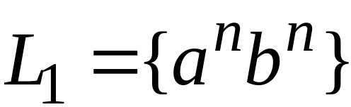
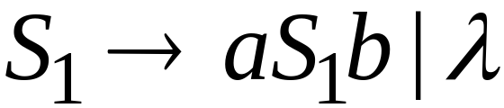
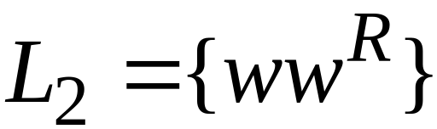
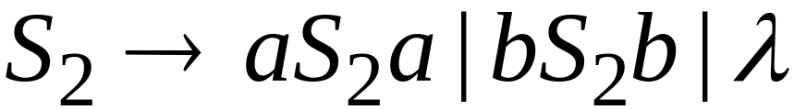
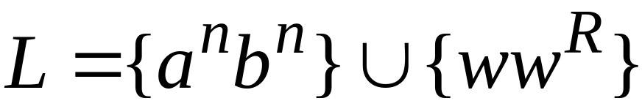

Example
Language
Grammar
Union

Slide 4
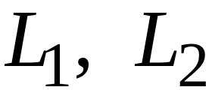
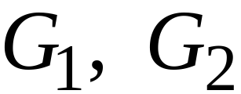
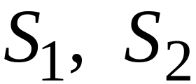

In general:
For context-free languages
with context-free grammars
and start variables
The grammar of the union
has new start variable
and additional production

Slide 5

Concatenation
Context-free languages
are closed under:
Concatenation
is context free
is context free
is context-free

Slide 6
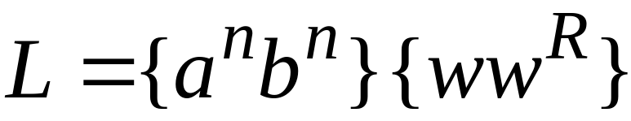
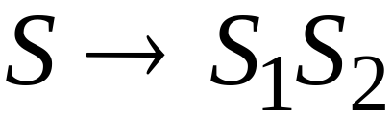
Example
Language
Grammar
Concatenation

Slide 7
In general:
For context-free languages
with context-free grammars
and start variables
The grammar of the concatenation
has new start variable
and additional production

Slide 8


Star Operation
Context-free languages
are closed under:
Star-operation
is context free
is context-free

Slide 9
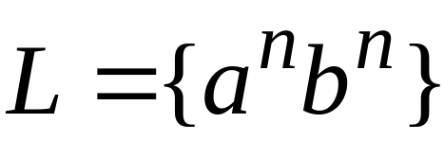
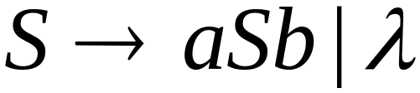
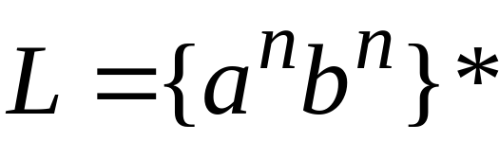
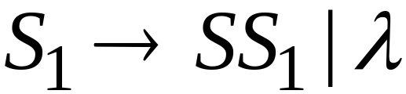
Example
Language
Grammar
Star Operation

Slide 10



In general:
For context-free language
with context-free grammar
and start variable
The grammar of the star operation
has new start variable
and additional production

Slide 11
Negative Properties of
Context-Free Languages

Slide 12

Intersection
Context-free languages
are not closed under:
intersection
is context free
is context free
not necessarily
context-free

Slide 13
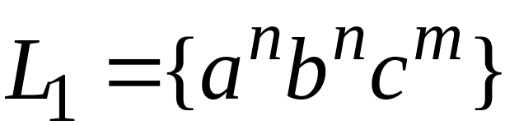
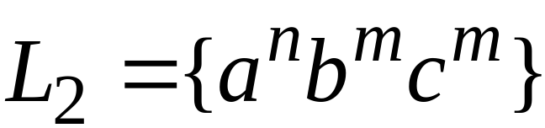
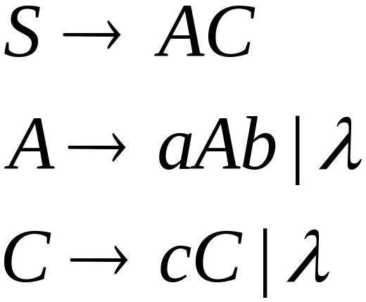
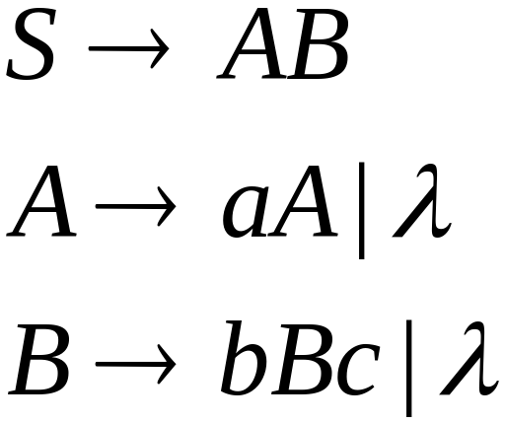
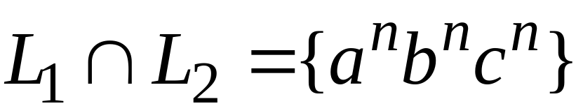
Example
Context-free:
Context-free:
Intersection
NOT context-free

Slide 14

Complement
Context-free languages
are not closed under:
complement
is context free
not necessarily
context-free

Slide 15
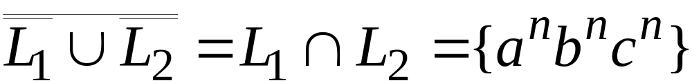
Example
Context-free:
Context-free:
Complement
NOT context-free

Slide 16
Intersection of
Context-free languages and
Regular Languages

Slide 17
The intersection of
a context-free language and
a regular language
is a context-free language
context free
regular
context-free

Slide 18



Machine
Machine
NPDA
for
DFA
for
context-free
regular
Construct a new NPDA machine
that accepts
simulates in parallel and

Slide 19
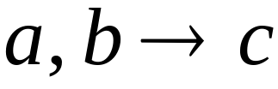




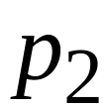
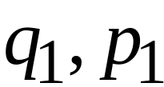
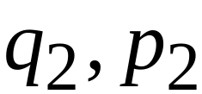
NPDA
DFA
transition
transition
NPDA
transition

Slide 20


NPDA
DFA
transition
NPDA
transition

Slide 21

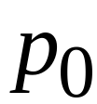
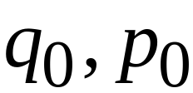
NPDA
DFA
initial state
initial state
NPDA
Initial state

Slide 22
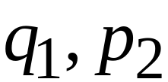
NPDA
DFA
final state
final states
NPDA
final states

Slide 23
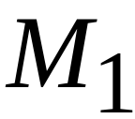









Example:
context-free
NPDA

Slide 24
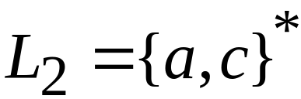
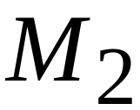


regular
DFA

Slide 25
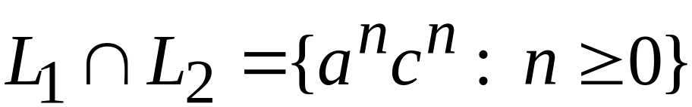





context-free
Automaton for:
NPDA

Slide 26


In General:
simulates in parallel and
accepts string
if and only if
accepts string and
accepts string

Slide 27
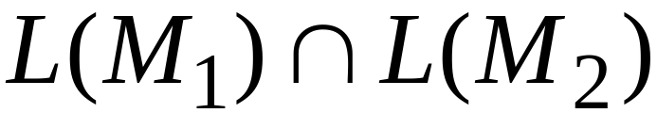
Therefore:
is NPDA
is context-free
is context-free

Slide 28
Applications of
Regular Closure

Slide 29
The intersection of
a context-free language and
a regular language
is a context-free language
Regular Closure
context free
regular
context-free

Slide 30
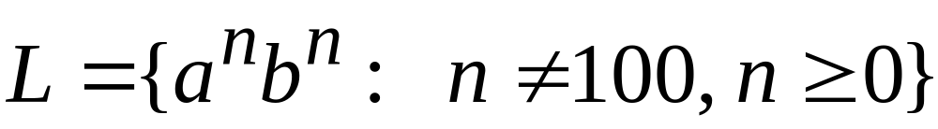
An Application of Regular Closure
Prove that:
is context-free

Slide 31

We know:
is context-free

Slide 32
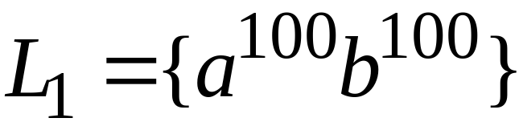
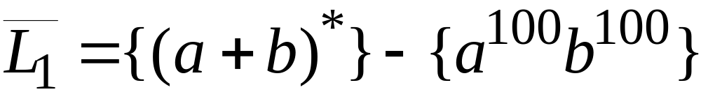
We also know:
is regular
is regular

Slide 33
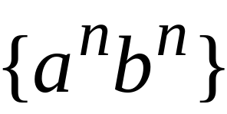
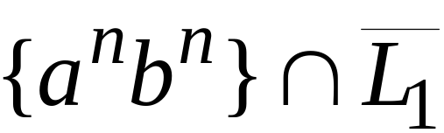
context-free
regular
(regular closure)
context-free
is context-free

Slide 34
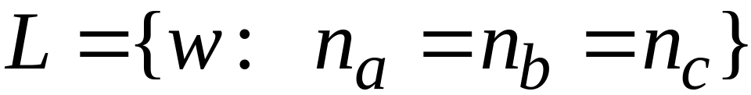
Another Application of Regular Closure
Prove that:
is not context-free

Slide 35
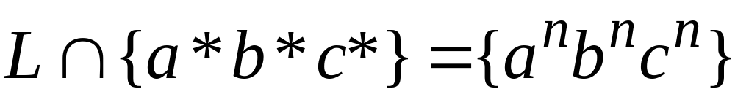
If
is context-free
(regular closure)
Then
context-free
regular
context-free
Impossible!!!
Therefore, is not context free

